Slide 1



Healthcare Operations and Financial Performance Dashboard
View in Power BI
Last data refresh:
3/30/2026 2:28:42 PM UTC
Downloaded at:
3/30/2026 2:43:30 PM UTC

Slide 2
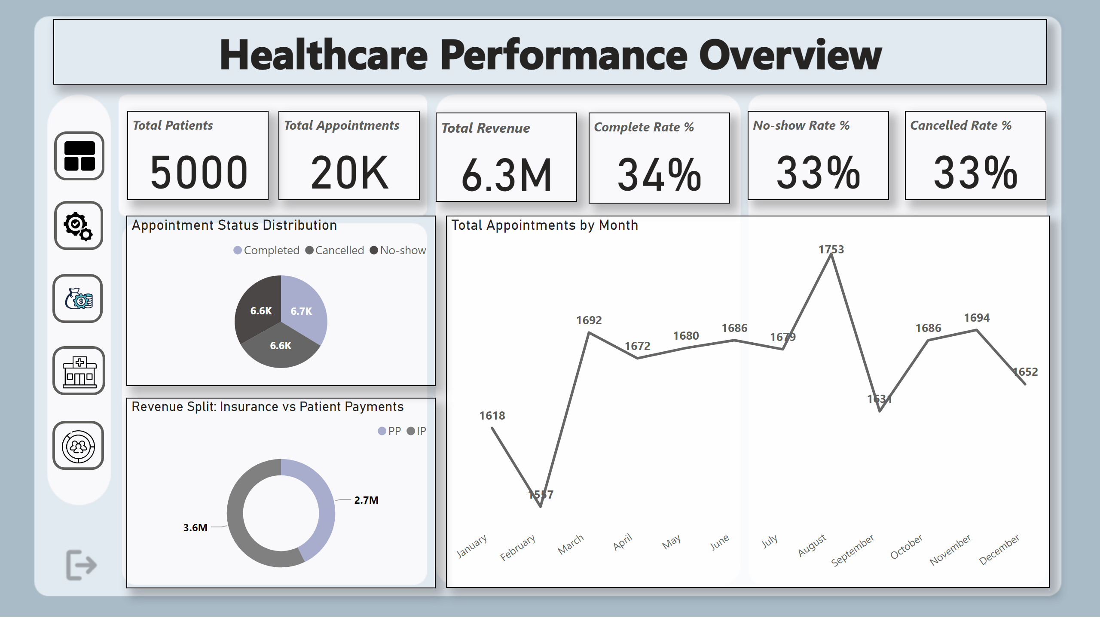
Overview
Notes:
card
No alt text provided
card
No alt text provided
card
No alt text provided
card
No alt text provided
card
No alt text provided
card
No alt text provided
Total Appointments by Month
No alt text provided
Appointment Status Distribution
No alt text provided
Revenue Split: Insurance vs Patient Payments
No alt text provided
actionButton
No alt text provided
image
No alt text provided
actionButton
No alt text provided
image
No alt text provided
actionButton
No alt text provided
image
No alt text provided
actionButton
No alt text provided
image
No alt text provided
actionButton
No alt text provided
image
No alt text provided
textbox
No alt text provided

Slide 3
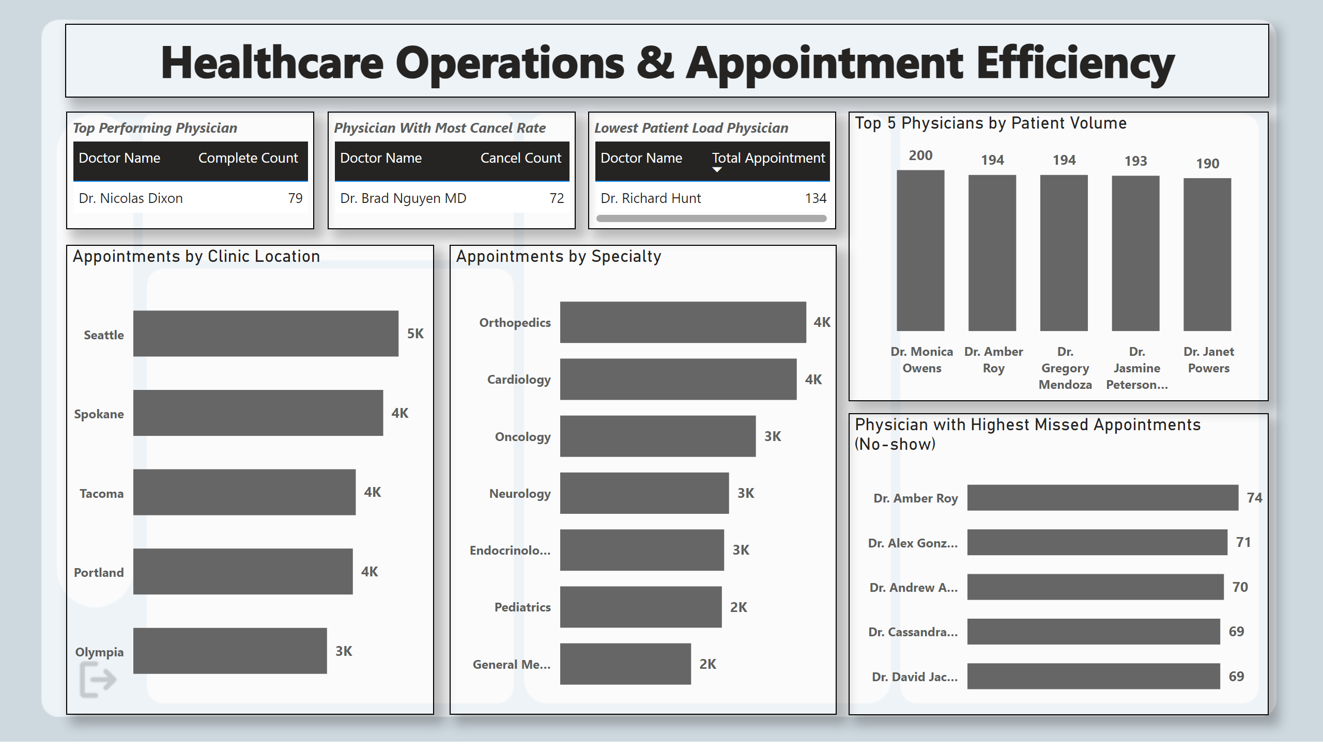
Operations
Notes:
Appointments by Clinic Location
No alt text provided
Appointments by Specialty
No alt text provided
Physician with Highest Missed Appointments (No-show)
No alt text provided
Top 5 Physicians by Patient Volume
No alt text provided
tableEx
No alt text provided
textbox
No alt text provided
tableEx
No alt text provided
tableEx
No alt text provided

Slide 4
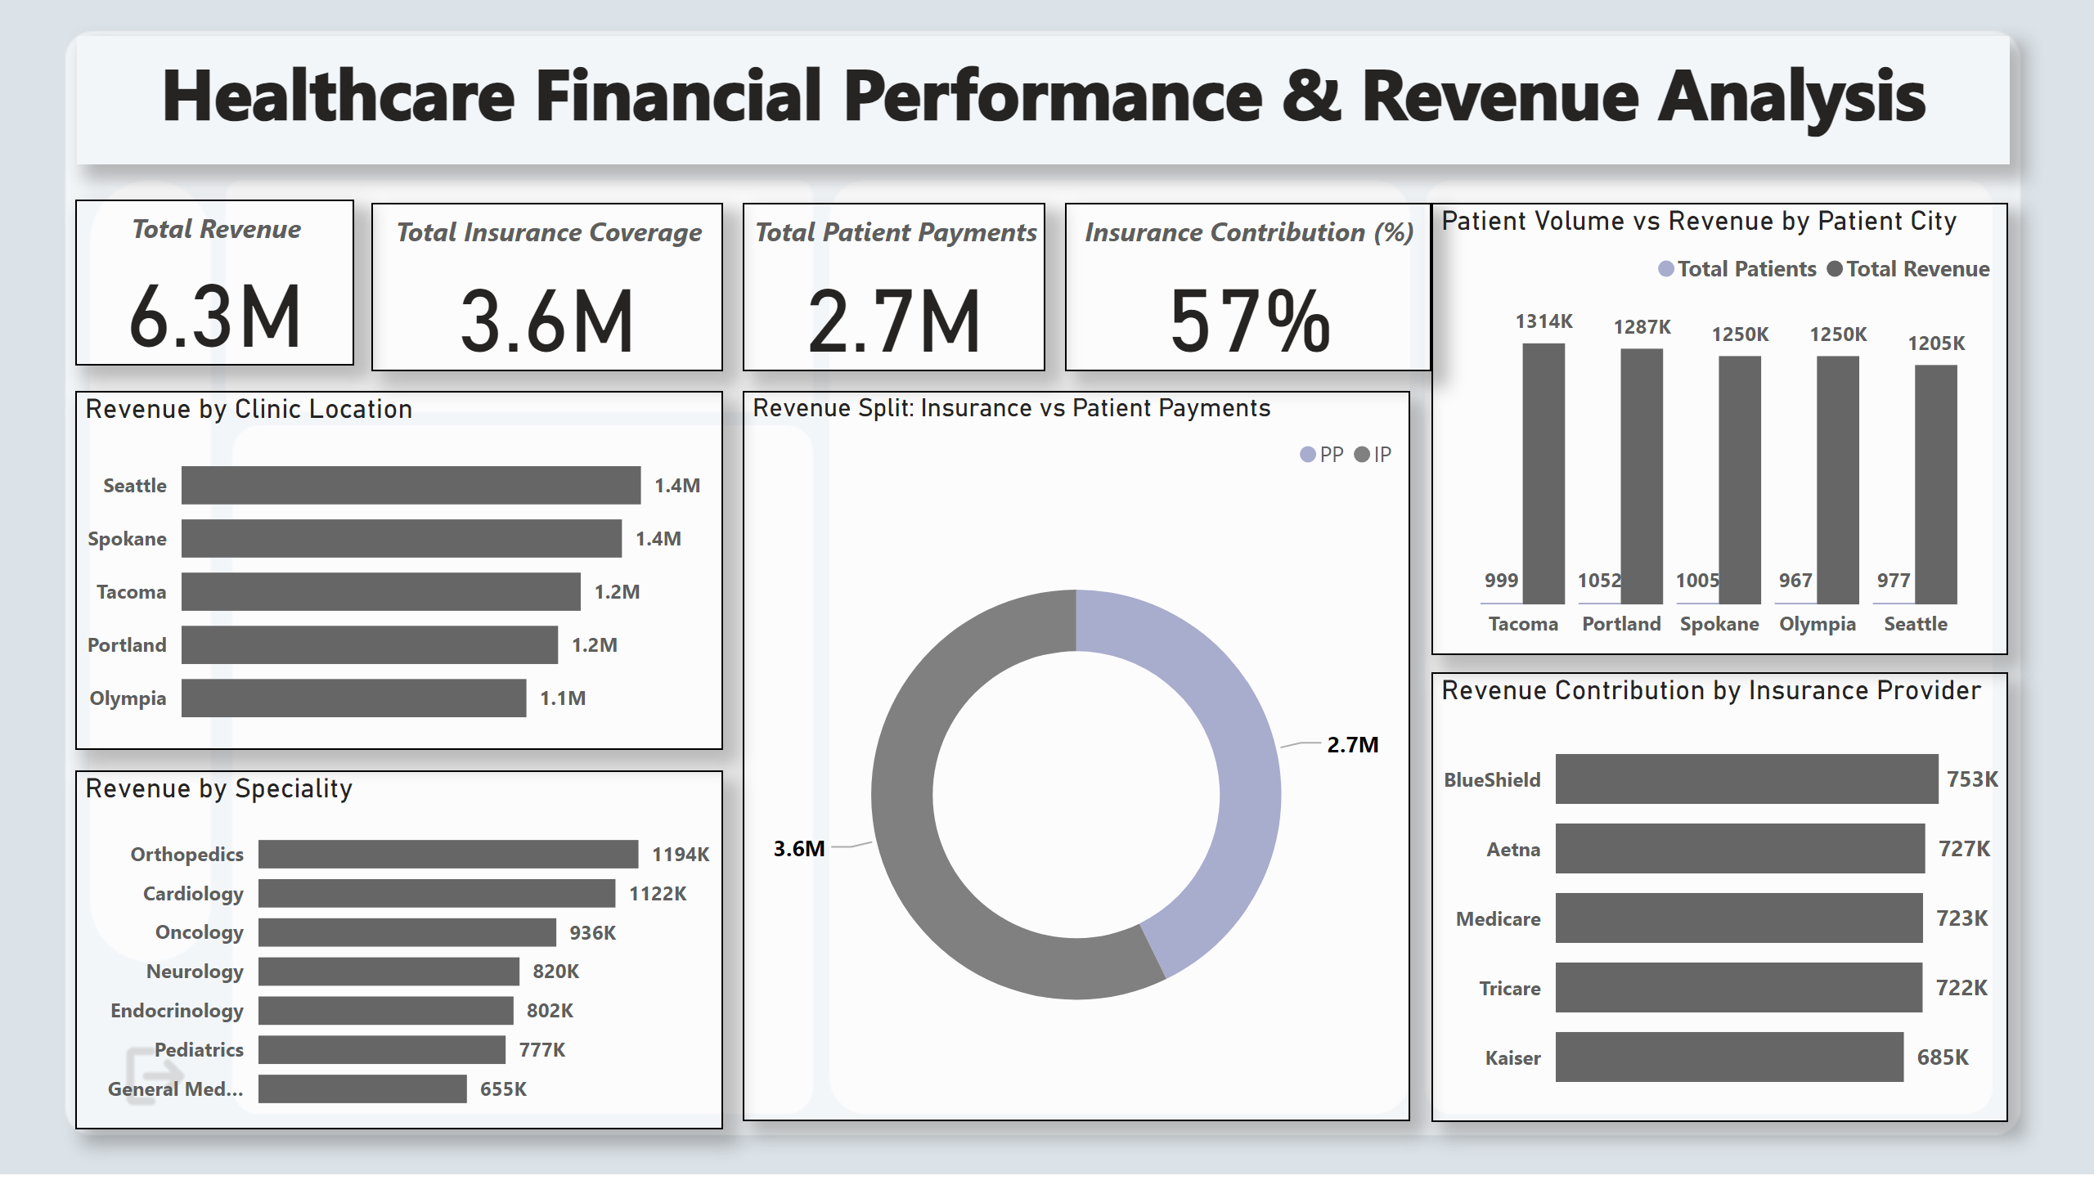
Financials
Notes:
card
No alt text provided
card
No alt text provided
card
No alt text provided
card
No alt text provided
Revenue by Clinic Location
No alt text provided
Revenue by Speciality
No alt text provided
Revenue Split: Insurance vs Patient Payments
No alt text provided
Revenue Contribution by Insurance Provider
No alt text provided
Patient Volume vs Revenue by Patient City
No alt text provided
textbox
No alt text provided

Slide 5
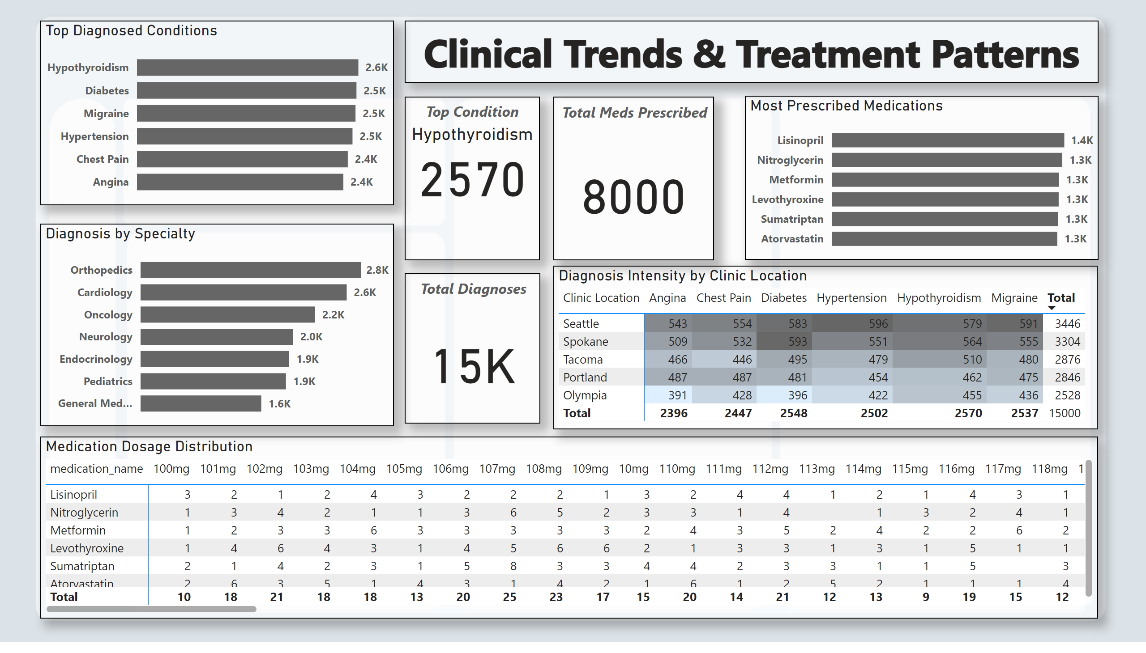
Clinical
Notes:
Diagnosis Intensity by Clinic Location
No alt text provided
card
No alt text provided
card
No alt text provided
card
No alt text provided
Medication Dosage Distribution
No alt text provided
Top Diagnosed Conditions
No alt text provided
Diagnosis by Specialty
No alt text provided
Most Prescribed Medications
No alt text provided
textbox
No alt text provided
kpi
No alt text provided

Slide 6
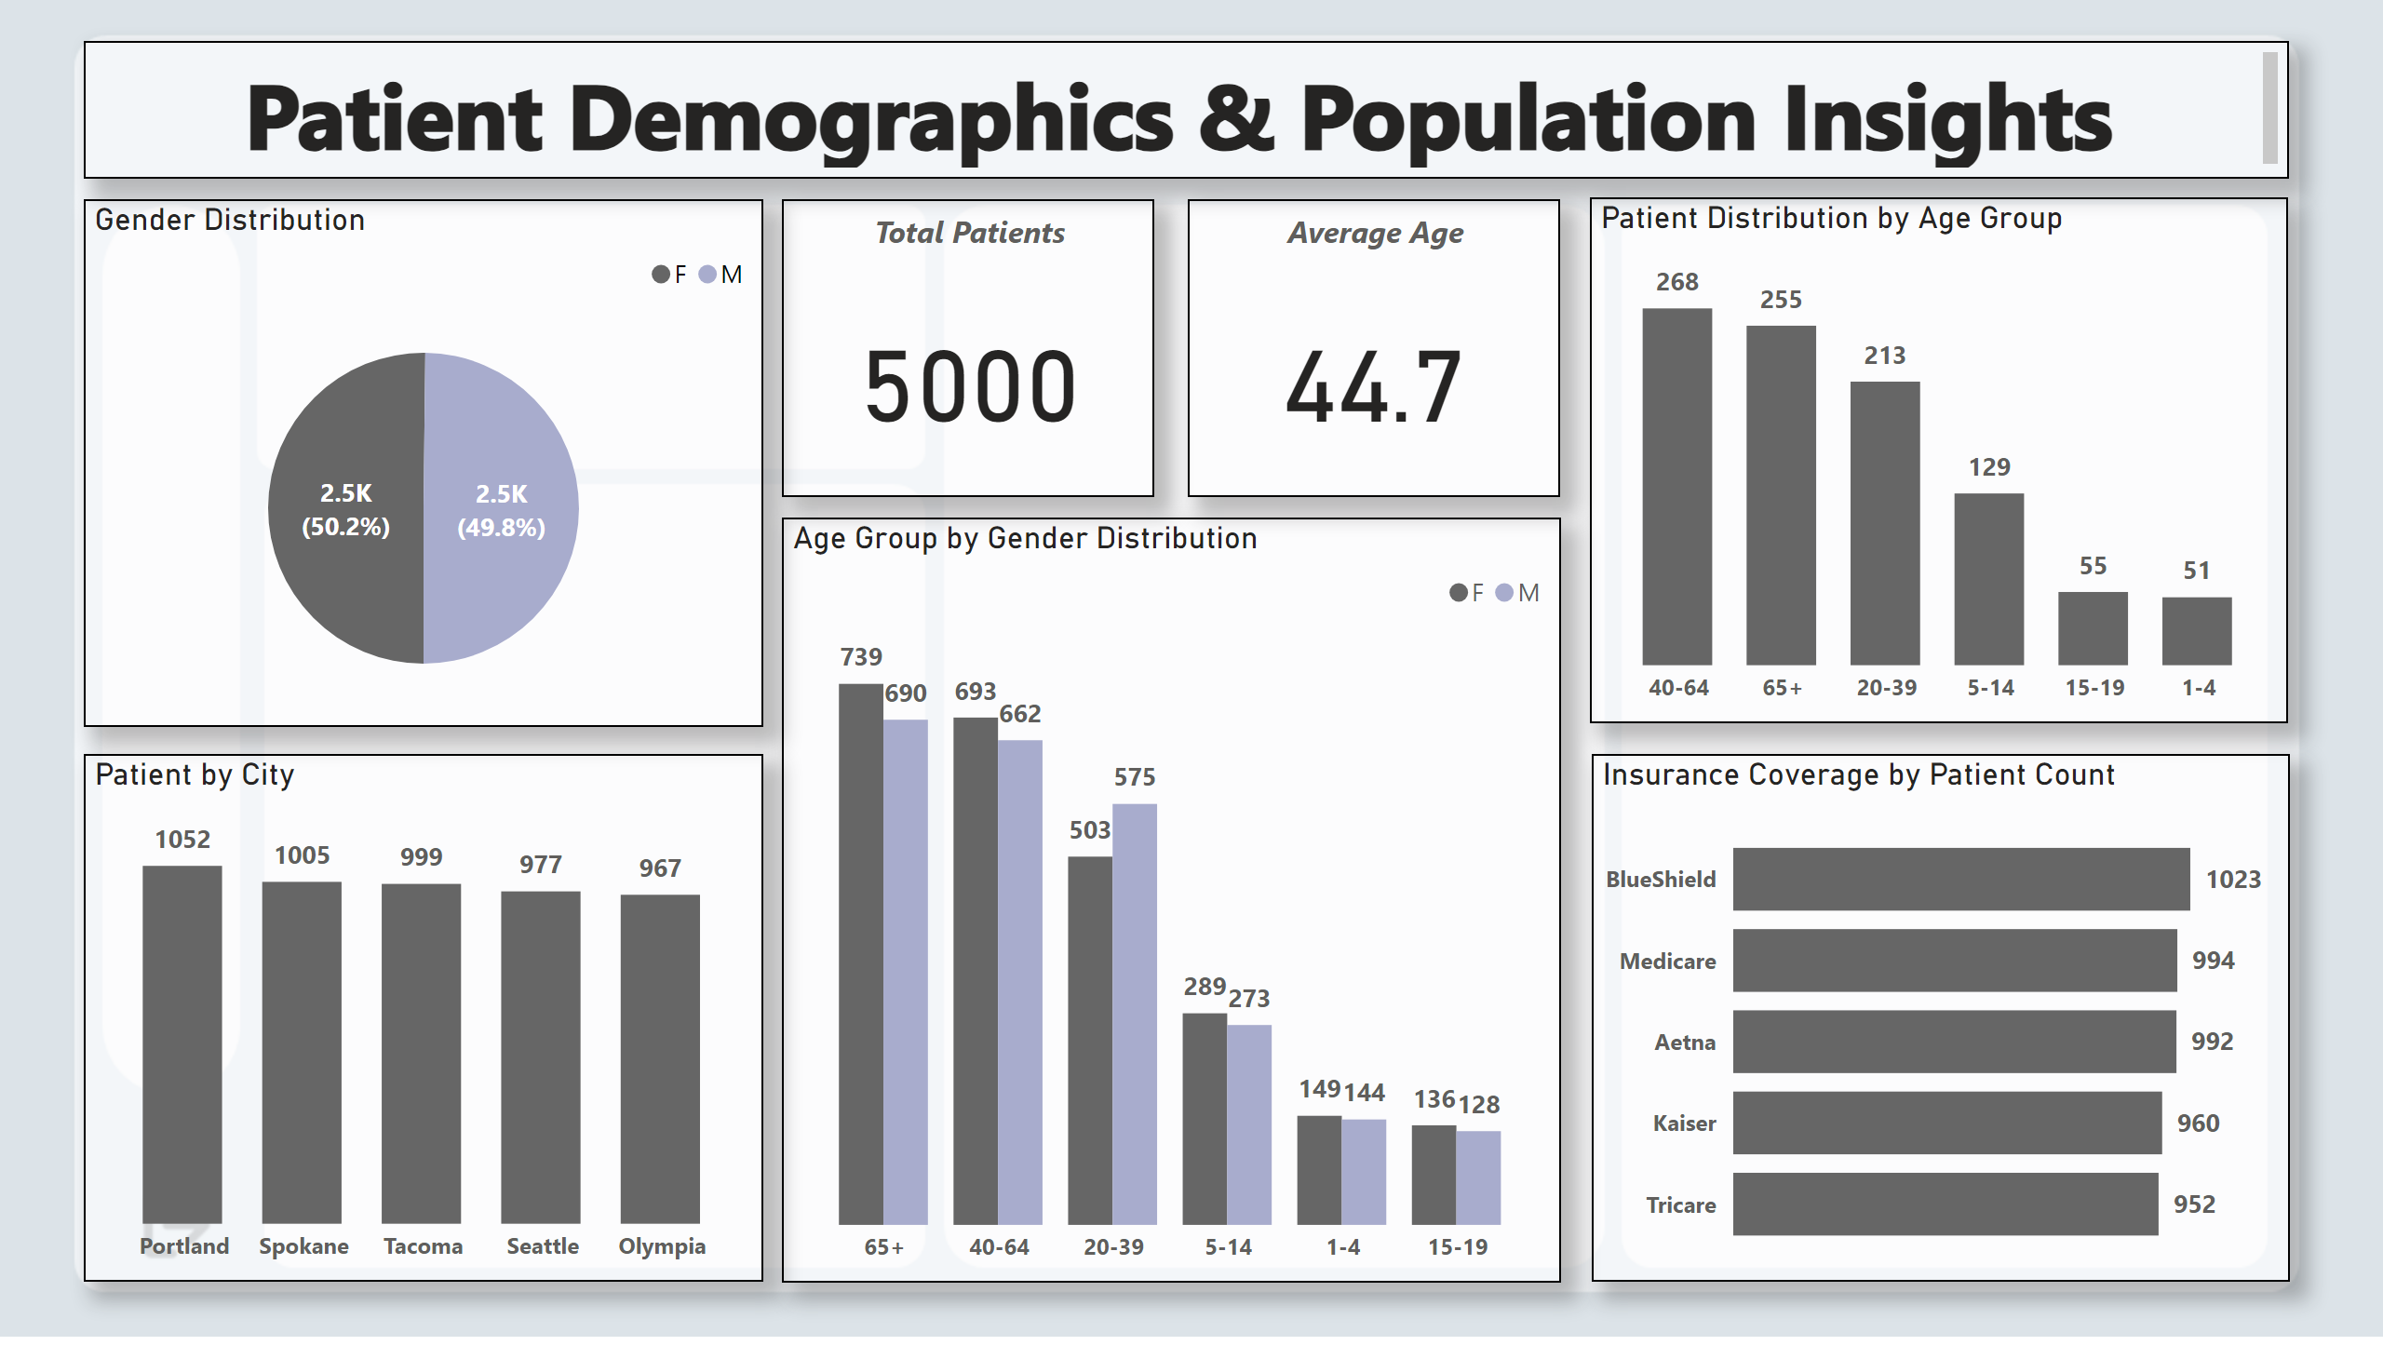
Demographics
Notes:
card
No alt text provided
Gender Distribution
No alt text provided
textbox
No alt text provided
Patient by City
No alt text provided
Insurance Coverage by Patient Count
No alt text provided
card
No alt text provided
Age Group by Gender Distribution
No alt text provided
Patient Distribution by Age Group
No alt text provided

